Slide 1


Student Notifier

Slide 2
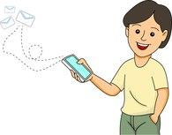
Introduction
Online college notification and feedback form is a combination of native app and web services. It is for college student and the purpose of the application is to notify the student about the daily class and college related activities, events, seminars, extra activities which are going to take place in and out of the university and it generate a feedback form every weekly,which take feedback from the student Which will help in understanding student problems, requirements and help in to take proper decisions which will overcome student problem.The student can also post the question on the mobile application in case of any query and the question will be seen by other student as well as faculty, whose so know or wish to answer the question can reply it.

Slide 3


Technology Used
For Web Services
In CodeIgniter which is one of the framework of php
CodeIgniter is based on the Model-View-Controller (MVC) development pattern. MVC is a software approach that separates application logic from presentation. In practice, it permits your web pages to contain minimal scripting since the presentation is separate from the PHP scripting.

Slide 4

For Android Application
Android is a mobile operating system developed by Google, based on the Linux kernel and designed primarily for touchscreen mobile devices such as smartphones and tablets.
Android application can be developed using Android Studio. Android Studio is the official integrated development environment (IDE) for Android platform development.

Slide 5

MySql Database
MySQL is the world's most popular open source database. With its proven performance, reliability and ease-of-use, MySQL has become the leading database choice for web-based applications, used by high profile web properties including Facebook, Twitter, YouTube, Yahoo and many more.

Slide 6

User Classes and Characteristics
For System Administrators
System administrators are primarily responsible for maintaining the system. One must have a basic understanding of computers and the internet as well as prior knowledge for operating web base programming knowledge and database. The administrator is responsible for maintaining database for the system. The administrator should able to perform following functions:
1) Inserting the student data in the database and managing database.
2) Updating the student data in regular time interval
3) Sending the message notification and feedback from web server to mobile application.

Slide 7
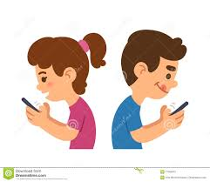
For Student
Students are the primary consumers of an system. One should have a basic knowledge to how to operate the android and IOS operating system mobile. The student should be able to perform the following functions:
1) Viewing the message send on mobile application.
2) Filling the feedback form send on mobile application and submitting it.
3) Posting the question and giving reply to posted question.

Slide 8

For Faculty
Faculty are also one of the important user of your sytem .They must have a basic understanding of computers and the internet. The faculty should able to perform the following functions:
Sending the message notification and feedback by login in to web server.
Replying to posted question.

Slide 9

Product Functions
1) Allow the administrator to add new student data to the existing data in database.
2) Allow administrator to remove data if it is unnecessary.
3) Allow administrator to update or edit data student and college data.
4) Allow the administrator to view each and every student detail.
5) Allow the administrator to send message notification and feedback form to mobile application.
6) Allow the administrator to send message notification and feedback form to mobile application.
7) Allow the student to view message notification and delete it.
8) Allow the student to fill feedback form and submit it.
9) Allow the student to post question in case of any query.
10) Allow the student and faculty to answer the posted question.

Slide 10
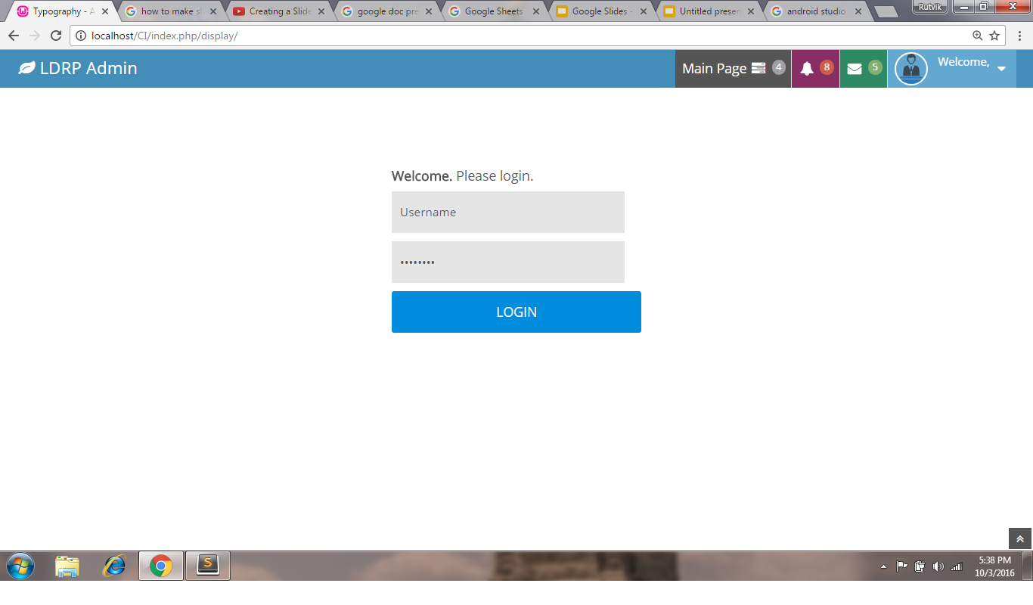
Login Page

Slide 11
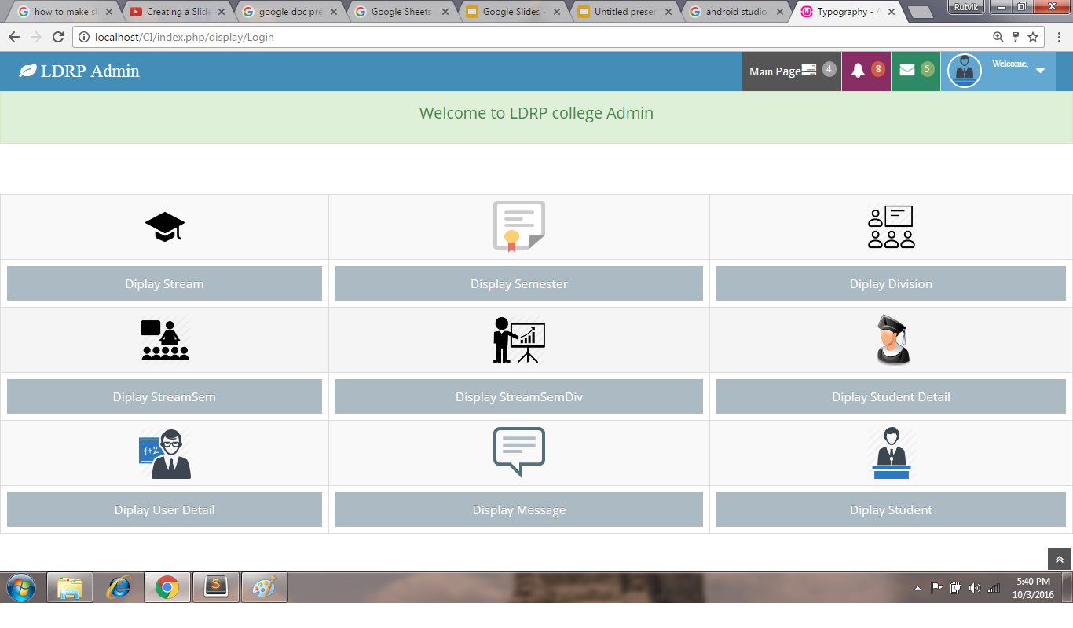
Main Page

Slide 12
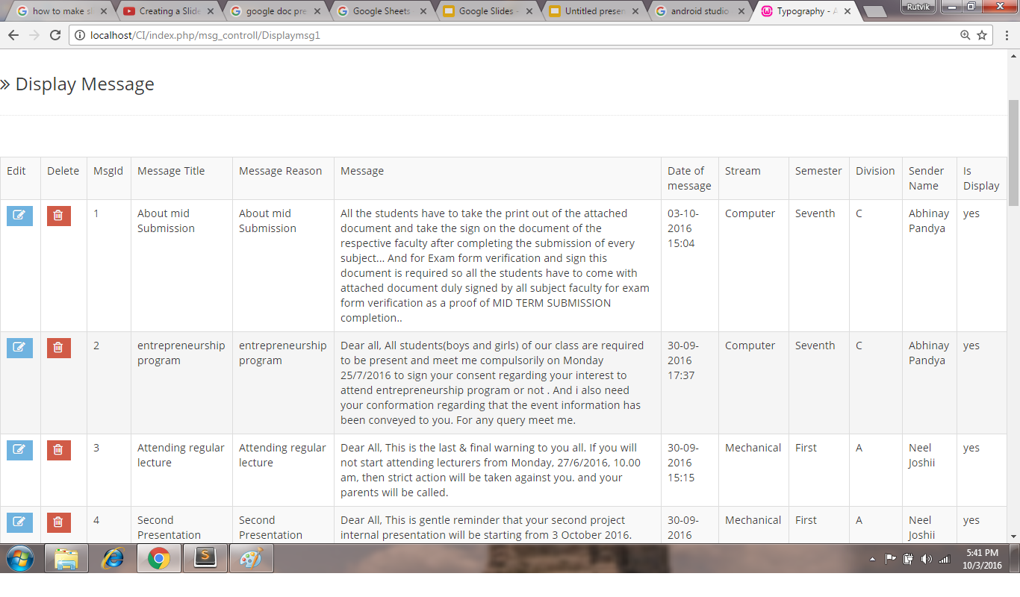
Display Page

Slide 13
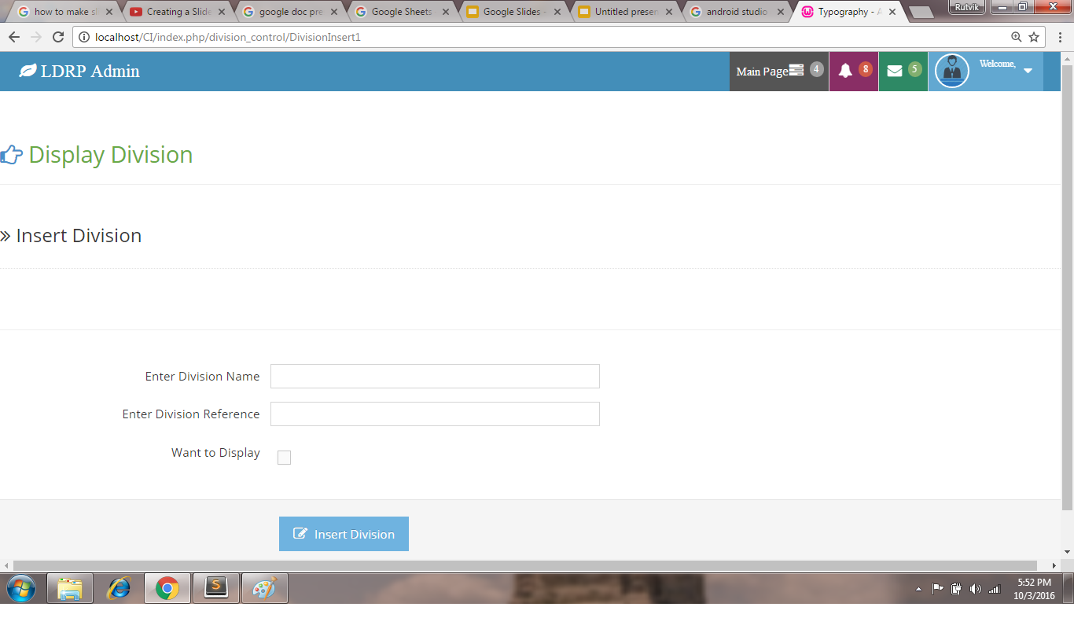
Insert Page

Slide 14
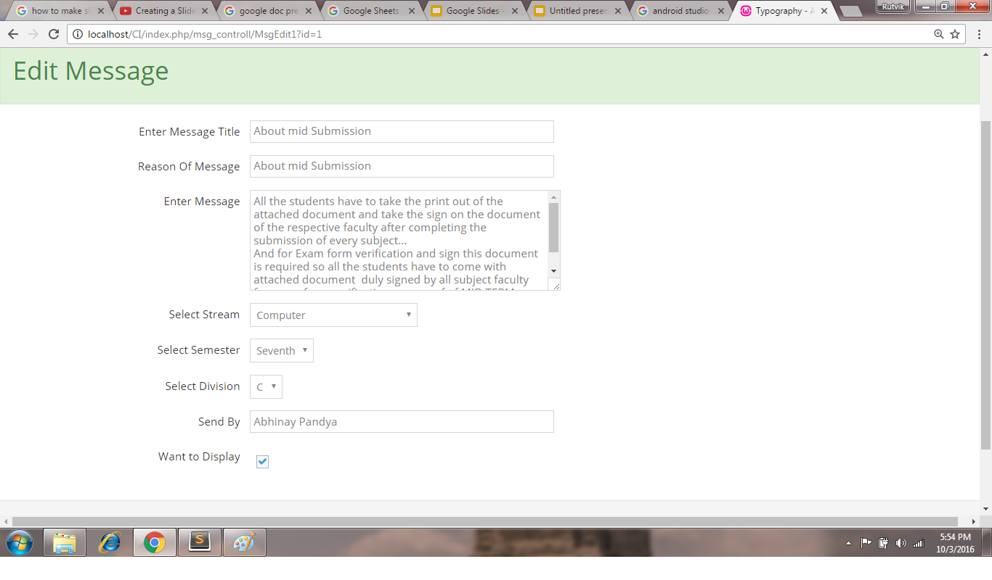
Edit page

Slide 15
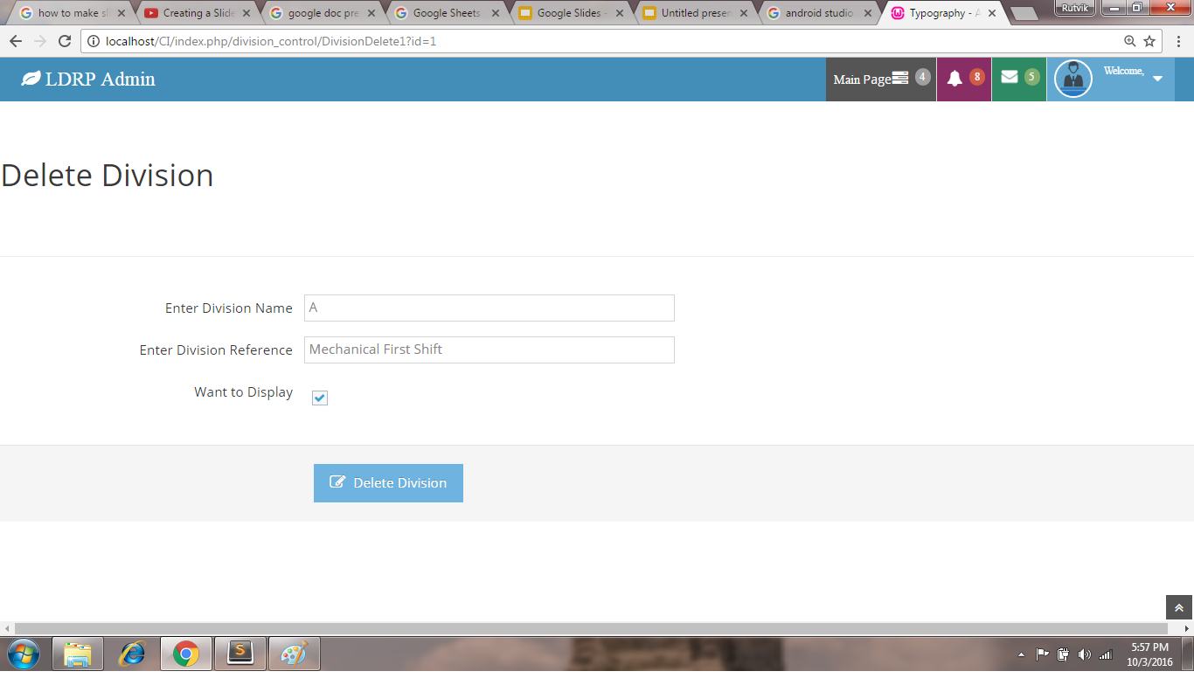
Delete page

Slide 16
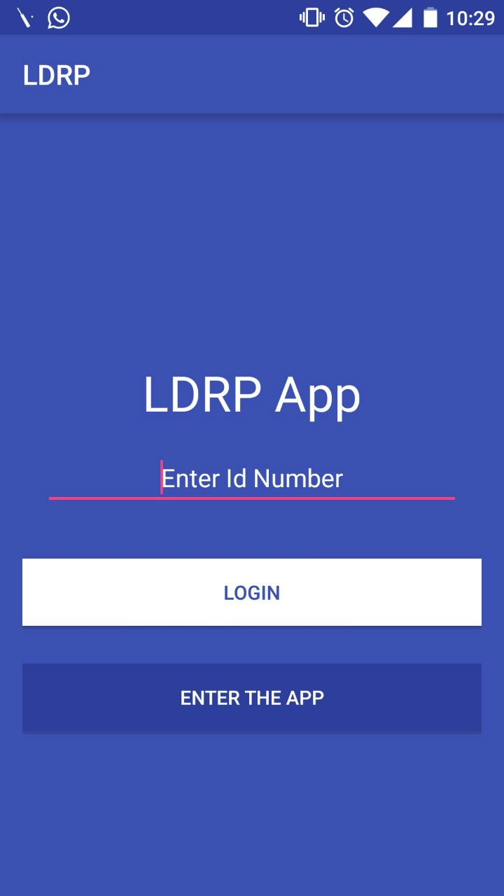
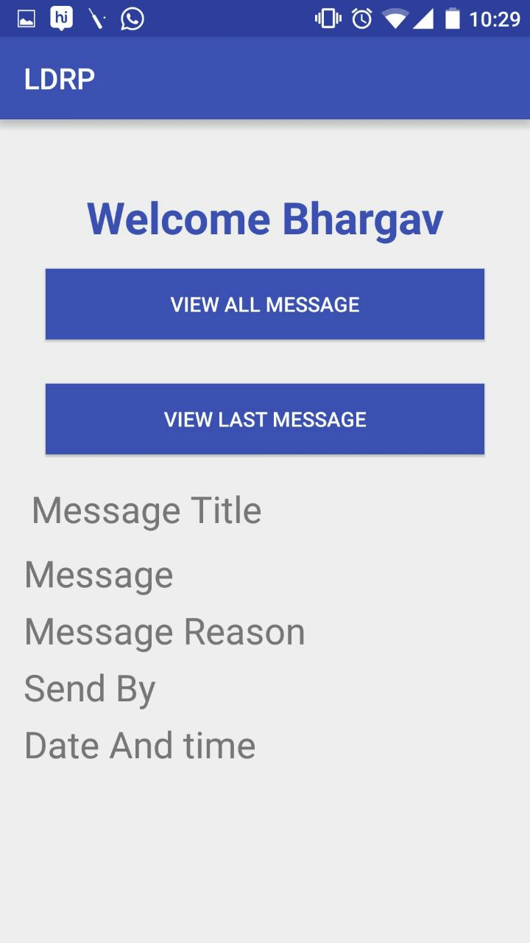
Login Page for mobile Application
Main page for mobile Application

Slide 17
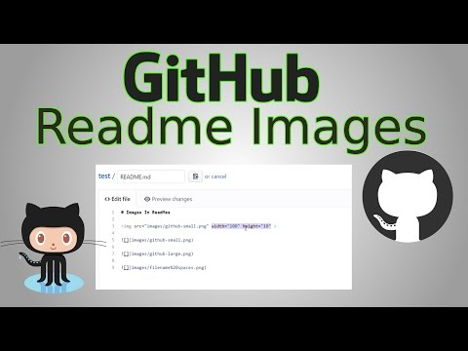
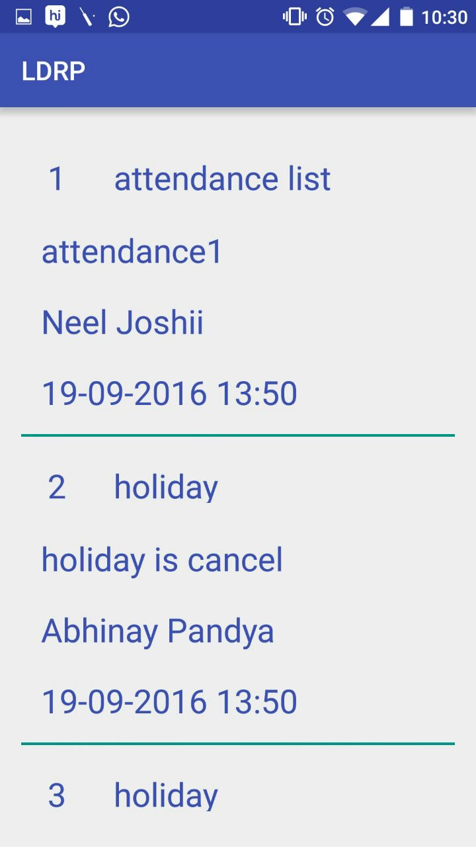
View message page for android application

